Slide 1
Object Oriented Programming using Java
SUKKUR IBA UNIVERSITY
Presented By:
Ghulam Mujtaba Shaikh

Slide 2
Pre-requisite of this course
Fundamental Programming

Slide 3
Course Objectives
Objective of this course is to make students familiar with the concepts of object-oriented programming
Concepts will be reinforced by their implementation in Java using IDE (Preferably by IntelliJ)

Slide 4
Course Outline
Basic Principles of OOP
Introduction to Java Programming
Java Basics
  Java Variables and Data types
  Java Operators
  Control Structures
  Arrays
Assignment 1 Due
OOP Language Concepts & their Implementation
  Encapsulation
  Abstraction
  Inheritance
  Polymorphism
  Packages & Interfaces
  Aggregation & Composition
Assignment 2 Due

Slide 5
Course Outline
Exception Handling
String Handling
Java Collections
Live Implementation of Project 1
IO Streams
Live Implementation of Project 2 (Extension of Project 1)
Assignment 3 Due
Java GUI Applications
Java Event Handling
Java Graphics and Animation
Game Development
Assignment 4 Due
JDBC Programming
Live Implementation of Project 3 (Extension of Project 2)
Semester Project Due and Exhibition

Slide 6
Recommended Books
Java 2 Complete Reference by Herbert Scheldt, Latest edition
Beginning Java 2 by Ivor Horton, Latest edition
Absolute Java by Walter Savitch and Kenrick Mock, Fifth Edition

Slide 7
Tools Needed for this course
JDK Latest Version
Notepad++
Command Prompt
IntelliJ IDE
PostgreSQL (For JDBC Topic)
GitHub for Code Management

Slide 8
Lecture 1
Introduction to OOP using Java

Slide 9
Topics to be Covered
Procedural versus OO Programing
Introduction to OOP
Recap

Slide 10
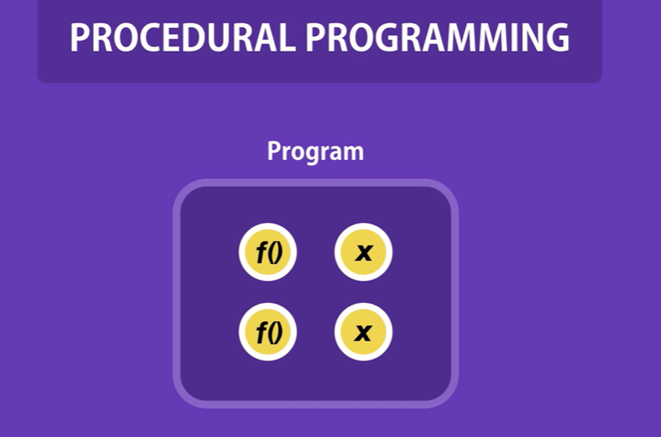
Procedural versus OOP

Slide 11
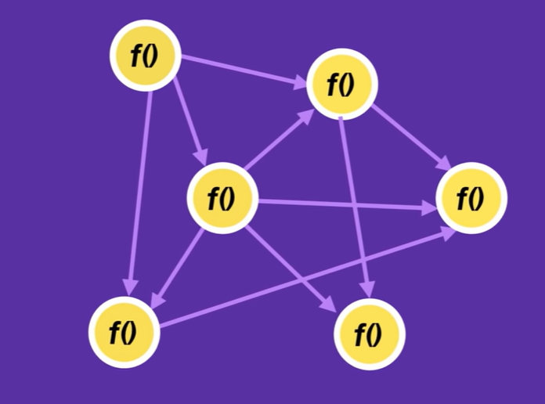
Procedural versus OOP
Too many functions.
Highly dependent.
If change in one function, may affect several others
Messy Code

Slide 12
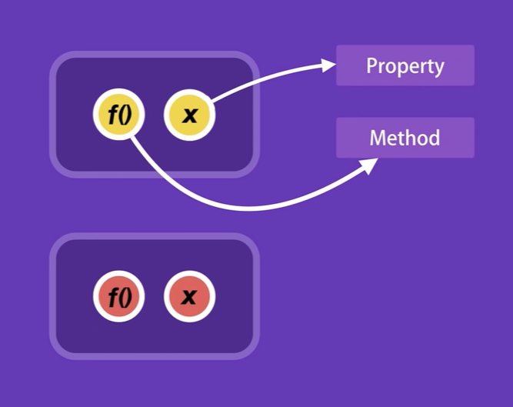
Procedural versus OOP
In OOP, we add related properties and methods into one unit called Class

Slide 13
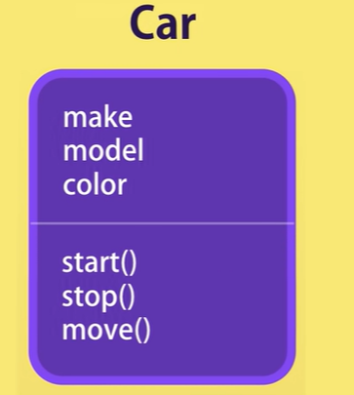
Procedural versus OOP
In OOP, we add related properties and methods into one unit called Class

Slide 14
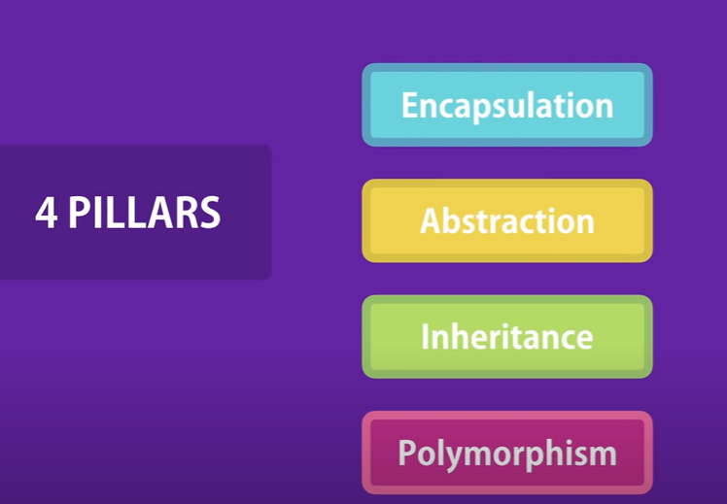
What is Object Oriented Programming (OOP) Language
In OOP, we create classes and objects. Apart from that it must have four key pillars

Slide 15
Classes and Objects
Class is a template.
Class is something which is logical and intangible in nature
Class is a tool for defining a new type
Example: Student, Person, Car, Menu, etc.
In an OO model, some of the objects exhibit identical characteristics (information structure and behavior)
We say that they belong to the same class
The class has properties and methods
Properties are the characteristics of the object of that class.
Methods are the behaviors of the object of that class.

Slide 16
Graphical Representation of Classes
(Class Name)
(Class Name)
(attributes)
(operations)
Suppressed Form
Normal Form

Slide 17
Example – Class
Ali studies mathematics
Anam studies physics
Sohail studies chemistry
Each one is a Student
We say these objects are instances or the representation of the Student class

Slide 18
Object
An object is the instance of the class or representation of a particular class. It is something tangible in nature.
Example:
  Ali may be the object of student class
  File Menu may be object of Menu class
An object has
  State (attributes)
  Well-defined behavior (operations)
  Unique identity

Slide 19
Example – Ali is a Tangible Object
State (attributes)
  Name
  Age
  cnic
behavior (operations)
  Walks
  Eats
Identity
  His cnic

Slide 20
Example – Car is a Tangible Object
State (attributes)
  - Color
  - Model
  - Registration number
behavior (operations)
  - Accelerate
  - Start Car
  - Change Gear
Identity
  - Its registration number

Slide 21
Recap
Procedural vs OOP Language
What is OOP Language?
What is a Class?
What is an Object?
What are properties, methods?

